Slide 1

DATA -602 Dermatology classification
Presented by
Chaithanya & Lokesh

Slide 2

Table of Contents
Introduction
About Data
Exploratory Data Analysis
Feature Selection
Model Experimentation & Evaluation
Conclusion

Slide 3
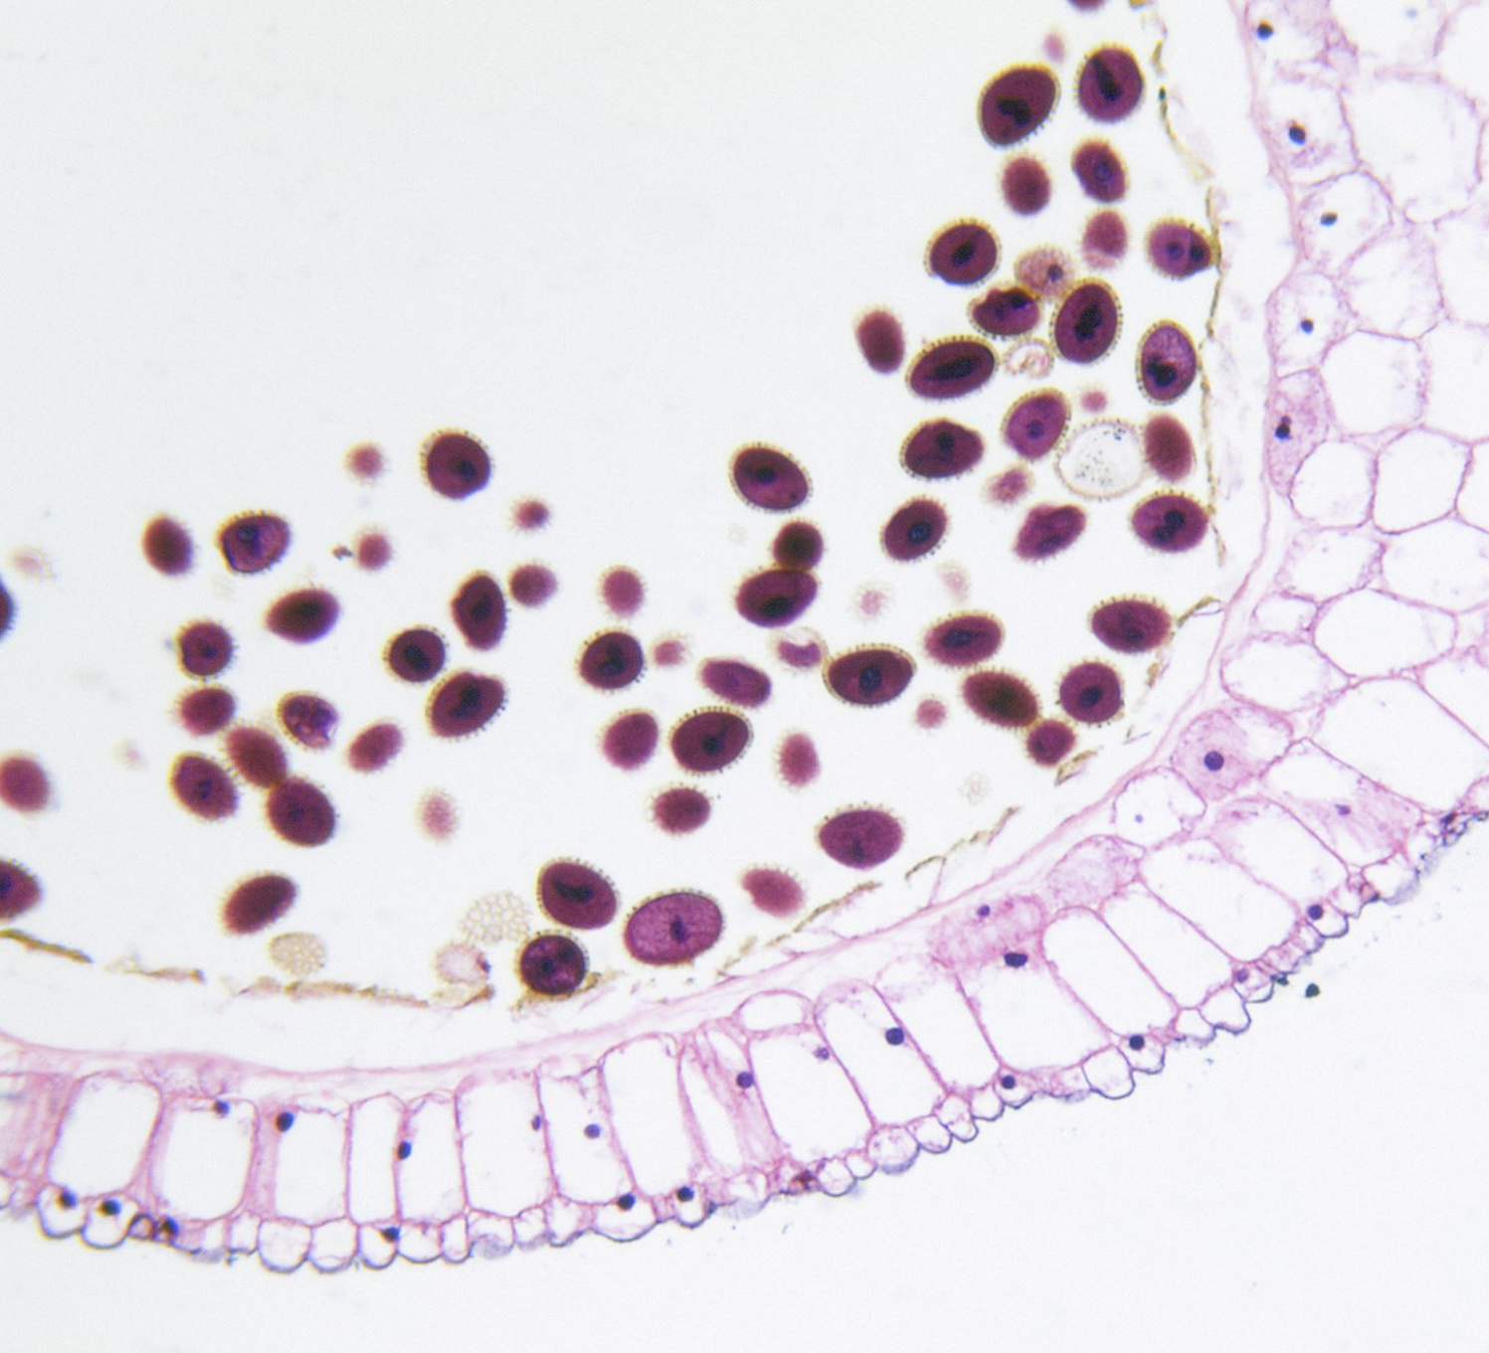
Introduction
Dermatology – It is branch of medicine that deals with skin and diseases of skin.
Erythemato-squamous diseases (ESDs) are common skin diseases. They consist of six different categories: psoriasis, seboreic dermatitis, lichen planus, pityriasis rosea, chronic dermatitis and pityriasis rubra pilaris.
These type of disease is difficult to detect by doctors as it slows the process of medication.

Slide 4

About the Data
We use dermatology dataset from UCI Machine Learning Repository.
The data has clinical and histopathological data in it.
We have 366 rows and 35 features in the dataset.
Every feature is given a degree in the range from 0 to 3 where 0 is not present and 3 indicates largest amount possible.
Out of all features 33 feature are linear and one feature (“Age”) is normally distributed.

Slide 5

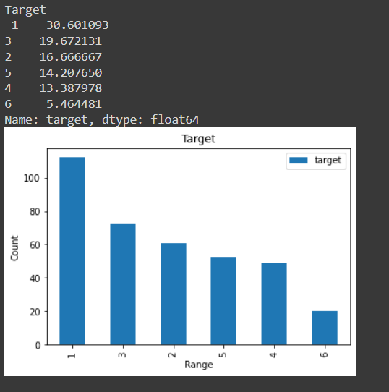
Exploratory Data Analysis
The data has 6 missing values in the feature Age. We used Random Forest Model and predicted the missing values and imputed it.
As it was medical data and all the features were in medical terms, we tried to research each feature. The explanation is given in the python notebook.
It seems that the data was imbalance, as the target which we were prediction was in different proportion.

Slide 6
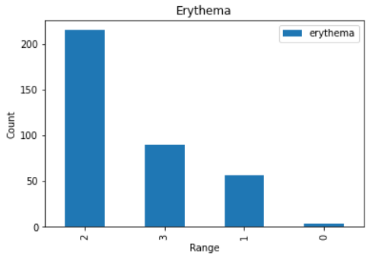
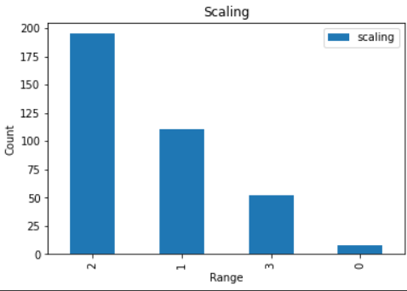
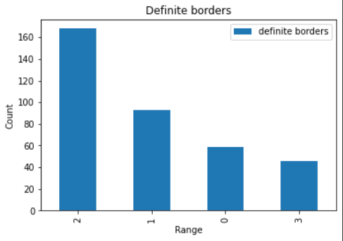
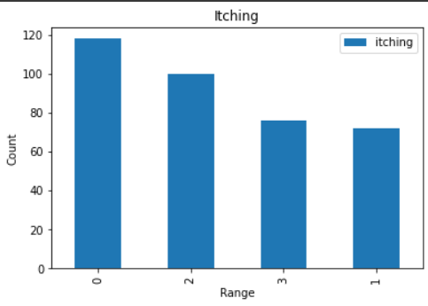
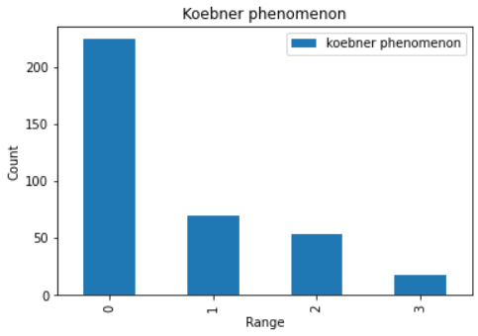
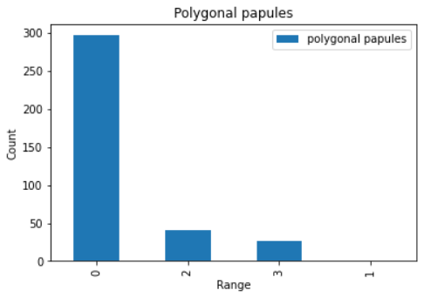
Univariate Analysis
We tried to do analysis on each feature and its trends through count.

Slide 7
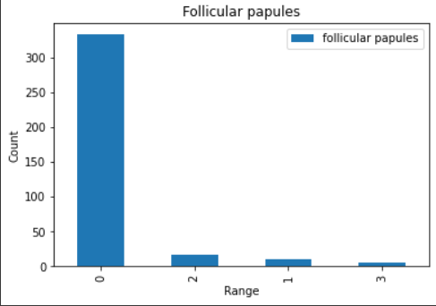
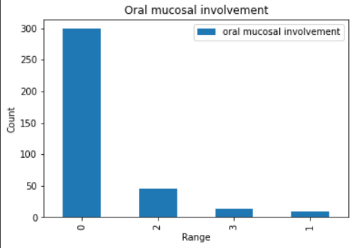
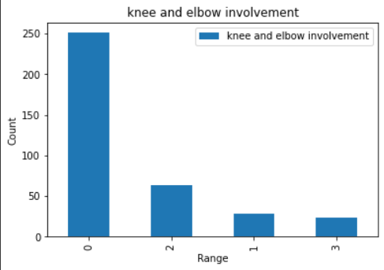
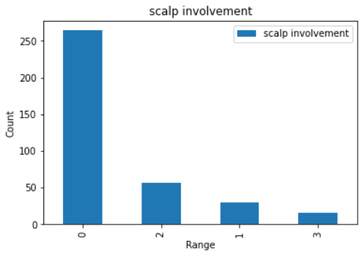
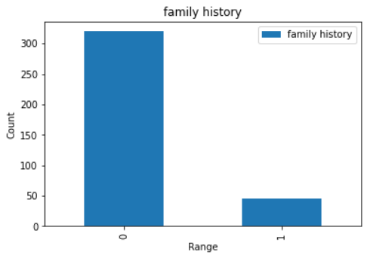
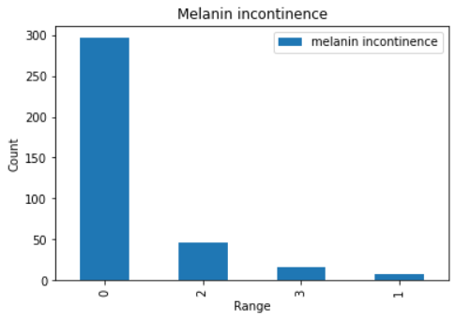
Univariate Analysis Continue…

Slide 8
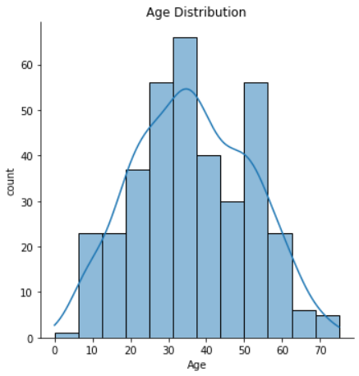
Univariate Analysis Continue…

Slide 9
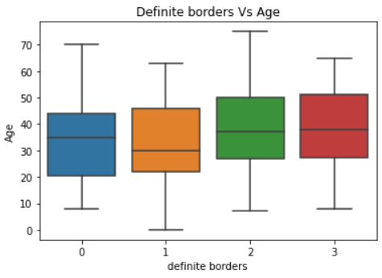
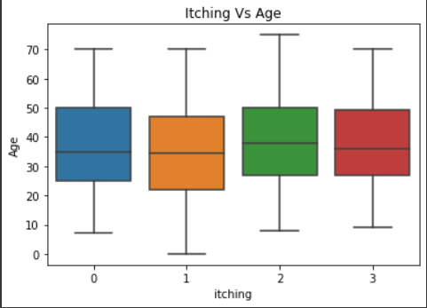
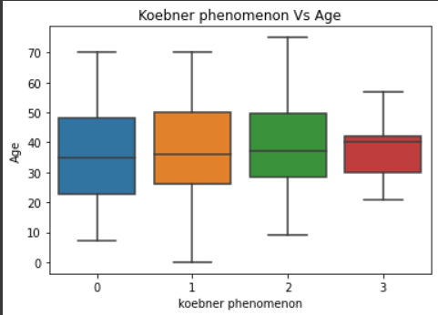
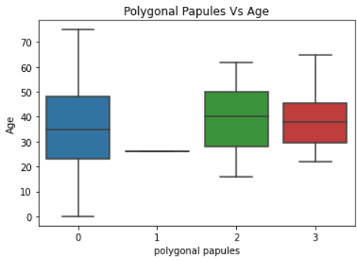
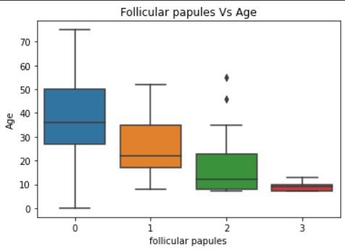
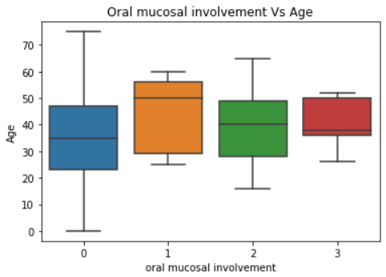
Bi Variate Analysis
We tried to understand every feature if it has any relation with the age
After the analysis, we understood that Age is not a significant factor with other features in the data. As these factors are independent to each other.

Slide 10

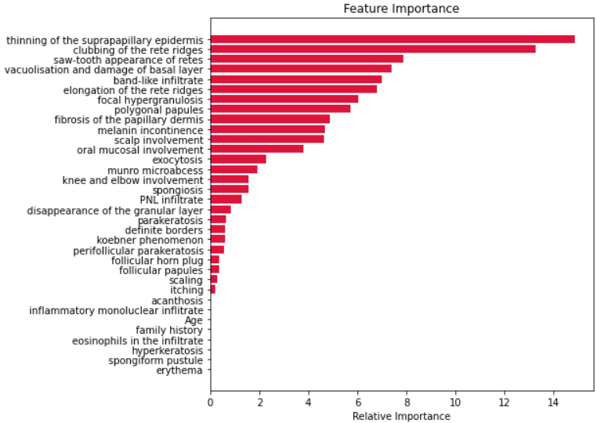
Feature Selection
Important Features which are affecting target
We run the Random Forest model on the data and tried to extract the important features.
Here we can see, Age is not a important feature as it was understood during the Analysis.

Slide 11
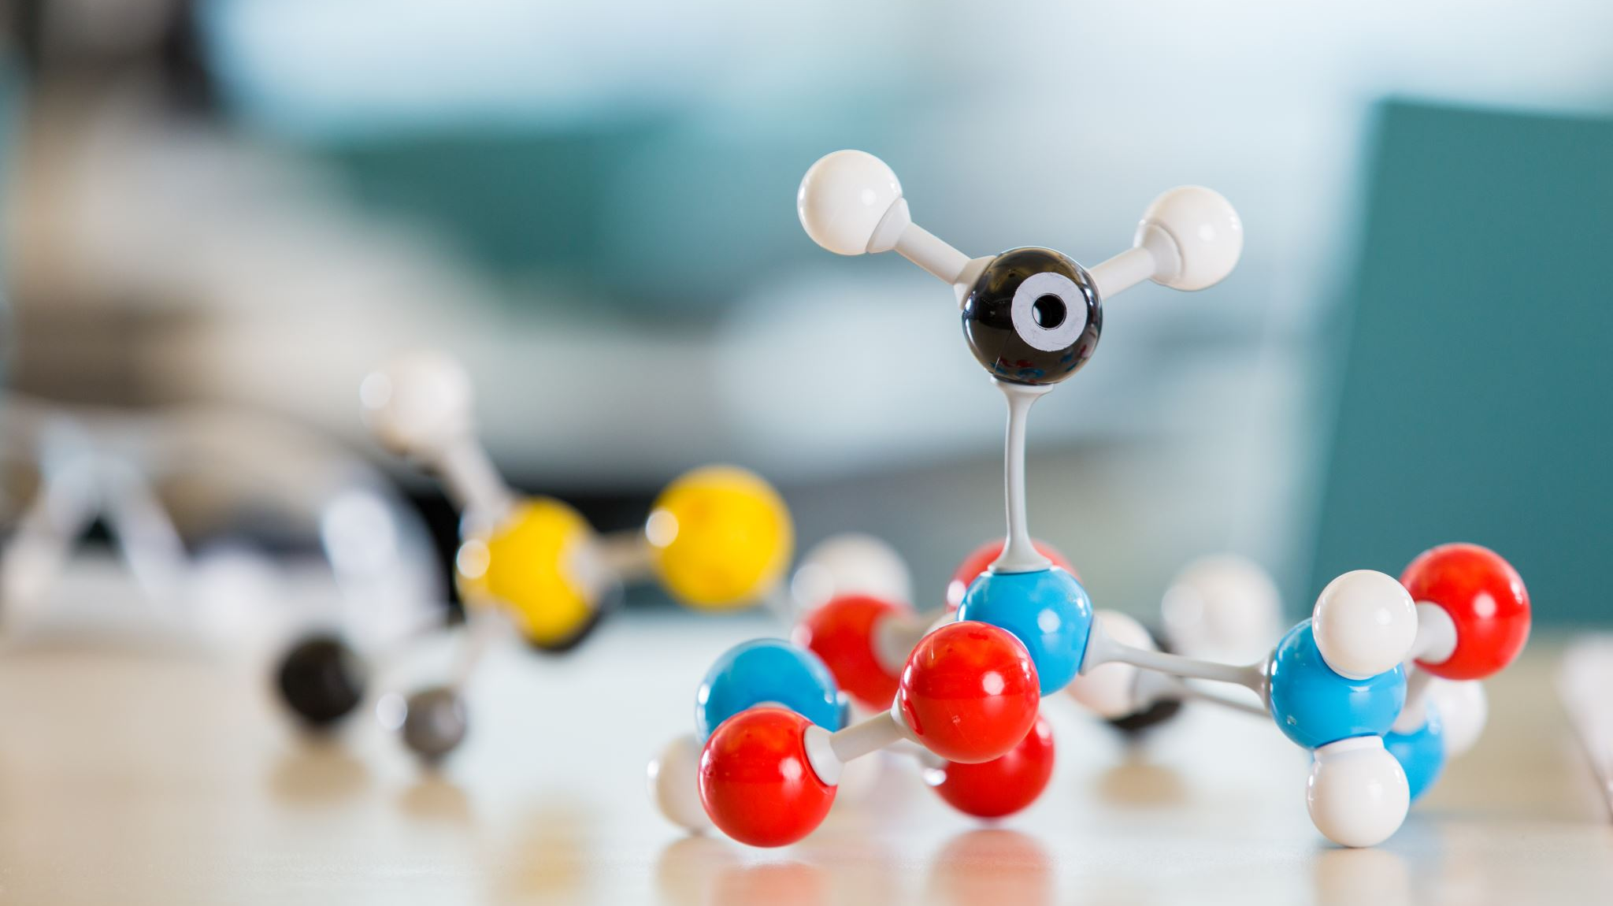
Model Experimentation
Since It was a multi-class classification problem and data is also imbalance. We tried to understand assumption of each ML algorithms which can perform well in this setting.
We used the following ML Model.
Support Vector Machine Classifier using Linear Kernel.
K- Nearest Neighbor with K = 6
Categorical Naïve Bayes
Random Forest
Gradient Boosting Classifier.

Slide 12

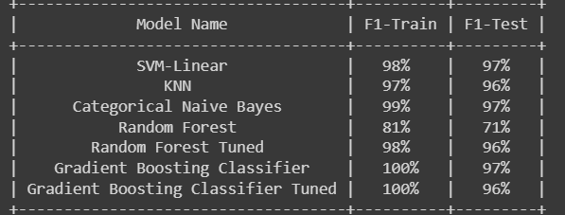
Model Evaluation
Since the data was imbalance, it was appropriate to use F1-Score which helps to understand precision and recall values much better.
Out of all the Classifiers Categorical Naïve Bayes performed well on train and test dataset.

Slide 13

Conclusion
In medical data, understanding each features and its values are very important to do further analysis.
Handling the missing values with domain knowledge is necessary when we have less data.
Multi-class Classification are different from Binary setting. Choosing the appropriate ML model is very essential to predict unseen data.
For Imbalance data, F-1 score is a right metric which helps to evaluate the model.

Slide 14

References
https://www.ncbi.nlm.nih.gov/pmc/articles/PMC5203752/
https://www.ncbi.nlm.nih.gov/pmc/articles/PMC5203752/
https://www.sciencedirect.com/science/article/abs/pii/S0952197612000218

Slide 15

ANY QUESTIONS?

